Slide 1
7 Principles of Software Testing
Software quality assurance engineer

Slide 2
7 Principles of Software testing:
1.Testing shows presence of defects
2.Exhaustive testing is not possible
3.Early testing
4.Defect clustering
5.Pesticide paradox
6.Testing is context dependent
7.Absence of errors fallacy

Slide 3
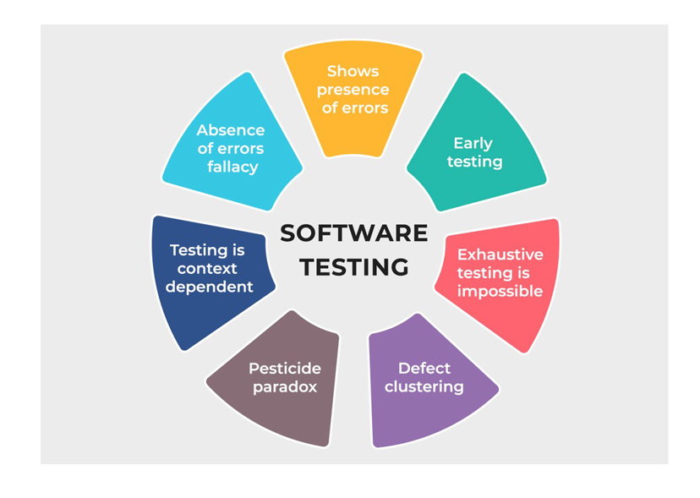

Slide 4
1.Testing shows presence of defects:
Testing can show the defects are present, but cannot prove that there are no defects. Even after testing the application or product thoroughly we cannot say that the product is 100% defect free. Testing always reduces the number of undiscovered defects remaining in the software but even if no defects are found, it is not a proof of correctness.

Slide 5
2.Exhaustive testing is impossible:
It is the process of testing the functionality of the software in all possible inputs (valid or invalid) and pre-conditions is known as exhaustive testing. Exhaustive testing is impossible means the software can never test at every test case. It can test only some test cases and assume that the software is correct and it will produce the correct output in every test case.

Slide 6
3. Early Testing:
To find the defect in the software, early test activity shall be started. The defect detected in the early phases of SDLC will be very less expensive. For better performance of software, software testing will start at the initial phase i.e. testing will perform at the requirement analysis phase.

Slide 7
4.Defect clustering:
In a project, a small number of modules can contain most of the defects. Pareto Principle to software testing state that 80% of software defect comes from 20% of modules.
This principle can help your team focus on the right area - the most popular software part.

Slide 8
5. Beware of the pesticide paradox:
Repeating the same test cases, again and again, will not find new bugs. So it is necessary to review the test cases and add or update test cases to find new bugs.
What's the solution?
Rethink and write more and better test cases, especially when it is a crucial part of the application. Preferably, use a code-coverage tool to ensure that your test cases cover all code paths.

Slide 9
6. Testing is context-dependent:
The testing approach depends on the context of the software developed. Different types of software need to perform different types of testing. For example, The testing of the e-commerce site is different from the testing of the Android application.
don't go for strategies without understanding your cost of quality - you don't want to spend more on quality than what you get in return. Put quality in the context of your product offering.

Slide 10
7. Beware of the absence-of-errors fallacy:
It is a common belief that a low defect rate implies the product is a success. This idea is the absence-of-errors delusion.
Zero defects do not mean the software solves end-user problems successfully.
If a built software is 99% bug-free but it does not follow the user requirement then it is unusable. It is not only necessary that software is 99% bug-free but it is also mandatory to fulfill all the customer requirements.

Slide 11
Thank you for being with testing

